Slide 1
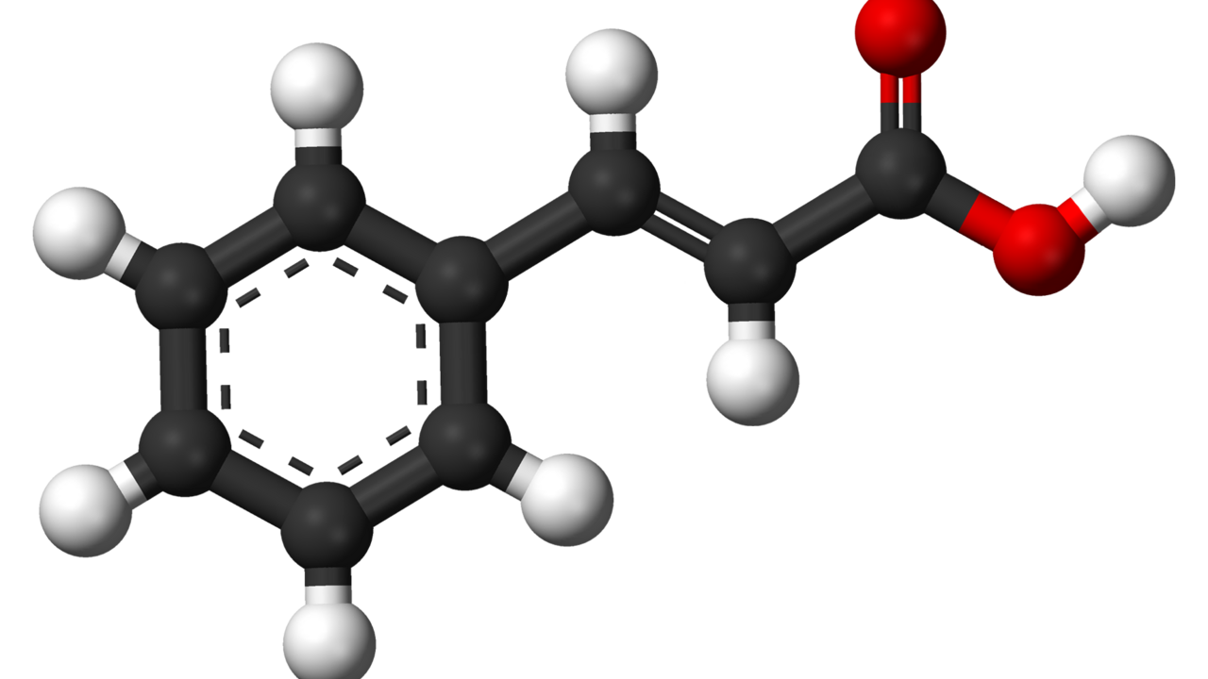

Cinnamon and Diabetes
Access the sources and research
By
Satvik Anand
& Sridhar Raj
Guide Teacher:Debyajoti Baral
anandsatvik11313@gmail.com

Slide 2
Research
To Explore the Effects of Cinnamon on Diabetes Type II and to compile a comprehensive study and usage plan from various previous research .
AIM: To Explore the effectiveness of cinnamon and explain its usage in countering diabetes

Slide 3
Understanding Type 2 Diabetes
Causes
Effects
Chronic disorder of glucose metabolism caused by pancreatic beta-cell dysfunction and insulin resistance.
Prevalence: Affects over 220 million people worldwide; projected increase to 366 million by 2030.
Symptoms: Elevated blood sugar levels, increased thirst, frequent urination, and fatigue.
Genetic predisposition and ageing
Obesity and physical inactivity
Poor dietary habits
Insulin resistance leads to high blood sugar
Damage to blood vessels and organs over time
Increased risk of heart disease and stroke​

Slide 4
95%
17%
Of diabetics are Indian
Diagnosed diabetes is Type II
Notes:
Type 2 diabetes was formerly called non-insulin dependent, or adult onset. Until recently, this type of diabetes was seen only in adults but it is now also occurring increasingly frequently in children. India has an estimated 100 million ^{[2]} people (1 in 10 Indians) formally diagnosed with diabetes, which makes it the second most affected in the world, after China.^{[3]} Furthermore, 700,000 Indians died of diabetes, hyperglycemia, kidney disease or other complications of diabetes

Slide 5
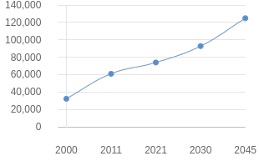
Graphs Showing statistics on prevalence of diabetes in India (per thousands)
Notes:
https://www.nature.com/articles/s41598-020-71908-9

Slide 6
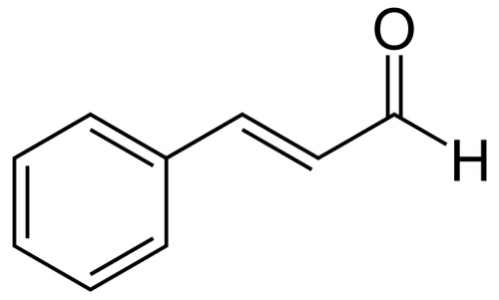
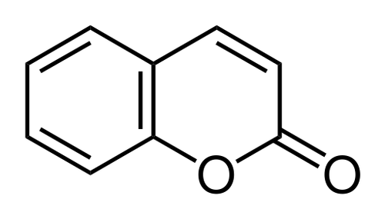
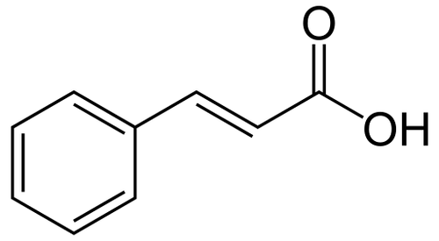
(True) Cinnamon
Botanical Name: Cinnamomum verum
History: A prized possession in the ancient world
Types :-
Ceylon Cinnamon
Sri Lanka India Myanmar
Cassia Cinnamon
China Indonesia
Saigon Cinnamon
Vietnam
Key Compounds: Contains polyphenols, cinnamaldehyde, coumarin(absent in true cinnamon), and cinnamic acid.
Benefits: Antioxidant, anti-inflammatory, and potential glucose-lowering properties​

Slide 7
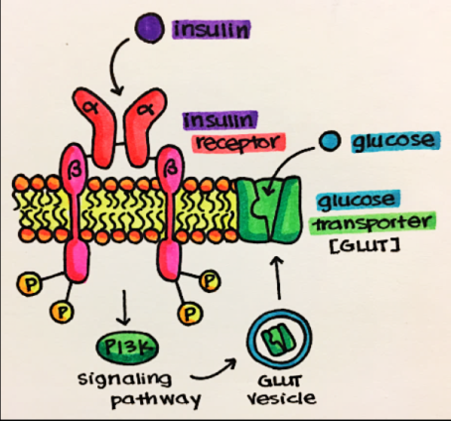

Normal Functioning of insulin receptors (Courtsey of @Kripath_patel)

Slide 8
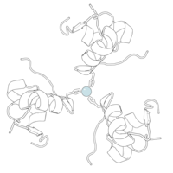

Mechanism of Action:
Research Findings
How Cinnamon Affects Blood Glucose
Polyphenols in cinnamon enhance insulin sensitivity.
Increases insulin receptor activity and glucose transporter efficiency.
Contains bioactive compounds that help reduce blood sugar spikes​
Some clinical trials highlight cinnamon's potential to lower blood glucose and HbA1c levels in diabetic and prediabetic patients, while others report minimal impact. Reasons for mixed results may include dosage differences, duration of intake, and variations in participants' diets.

Slide 9
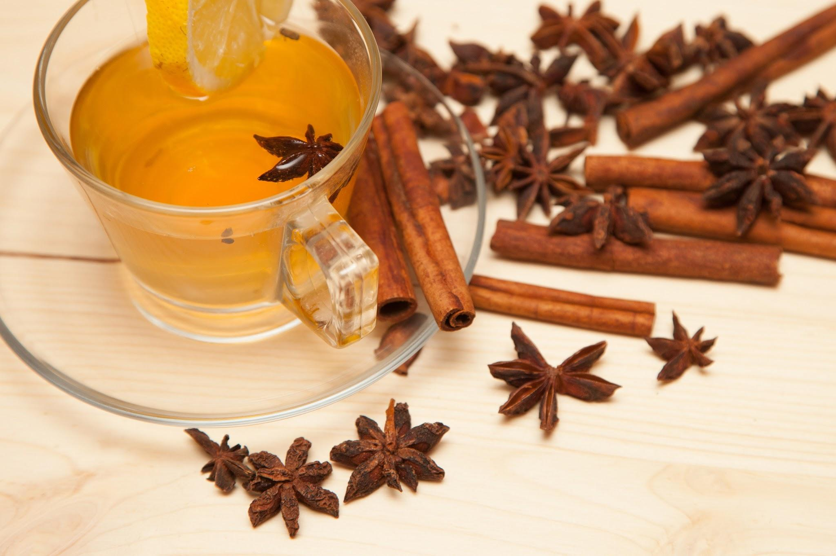
Recommended Dosage and Usage of Cinnamon
Typical Dosage: Studies often use 1-6g per day; larger doses generally yield better results.
Usage Recommendations:
Daily Dosage: Up to 6g per day (e.g. 2 teaspoons).
Ingestion: Add to meals, drinks, or use in capsules for precise dosing.
More absorption when taken in hot water.
Duration: Benefits observed with long-term use, often over 4-12 weeks​

Slide 10
Conclusion
Supporting Health: Natural supplements like cinnamon can aid in managing conditions such as Type 2 diabetes by enhancing insulin sensitivity and reducing inflammation.
Science Meets Tradition: Traditional remedies, validated by research, offer valuable support alongside conventional treatments.
Personalized Use: Supplements should complement individual health needs under professional guidance for safety and effectiveness.

Slide 11

What will I do next?
Try to figure out more about functioning of various molecules in the various biochemical processes in nature ; try to understand it better.

